Slide 1
Algorithmic Frameworks
Chapter 14 (starting with 14.2 - Parallel Algorithms)

Slide 2
Parallel Algorithms
Models for parallel machines and parallel processing
Approaches to the design of parallel algorithms
Speedup and efficiency of parallel algorithms
A class of problems NC
Some parallel algorithms (not all in the textbook)

Slide 3
What is a Parallel Algorithm?
Imagine you needed to find a lost child in the woods.
Even in a small area, searching by yourself would be very time consuming
Now if you gathered some friends and family to help you, you could cover the woods much faster.

Slide 4
Parallel Architectures
Single Instruction Stream, Multiple Data Stream (SIMD)
  One global control unit connected to each processor
Multiple Instruction Stream, Multiple Data Stream (MIMD)
  Each processor has a local control unit

Slide 5
Architecture (continued)
Shared-Address-Space
  Each processor has access to main memory
  Processors may be given a small private memory for local variables
Message-Passing
  Each processor is given its own block of memory
  Processors communicate by passing messages directly instead of modifying memory locations

Slide 6
Interconnection Networks
Static
  Each processor is hard-wired to every other processor
Dynamic
  Processors are connected to a series of switches
Completely Connected
Star-Connected
Bounded-Degree (Degree 4)

Slide 7
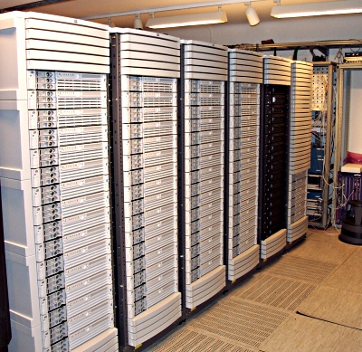
There are many different kinds of parallel machines – this is only one type
A parallel computer must be capable of working on one task even though many individual computers are tied together.
Lucidor is a distributed memory computer (a cluster) from HP. It consists of 74 HP servers and 16 HP workstations. Peak: 7.2 GFLOPs
GFLOP = one billion decimal number operations/second
source:http://www.pdc.kth.se/compresc/machines/lucidor.html

Slide 8
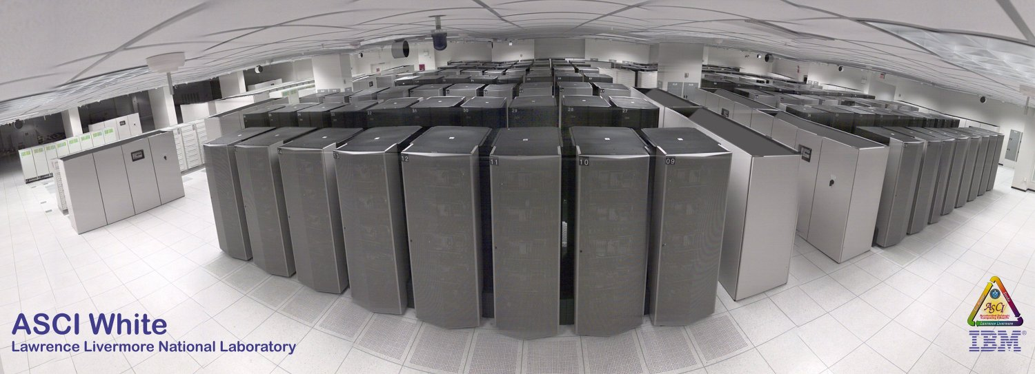
ASCI White (10 teraops/sec)
Third in ASCI series
IBM delivered in 2000

Slide 9
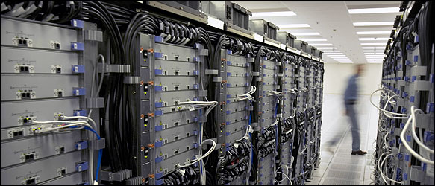
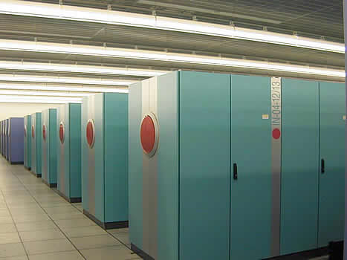
Some Other Parallel Machines
Blue Gene
Earth Simulator

Slide 10
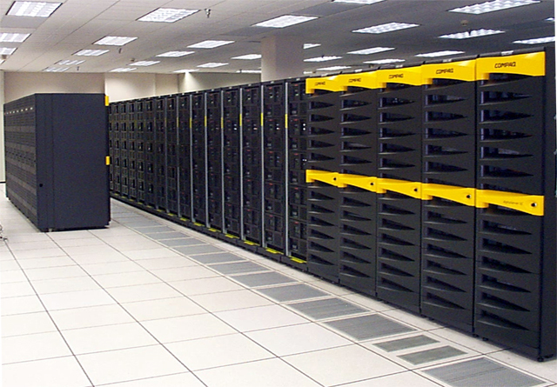
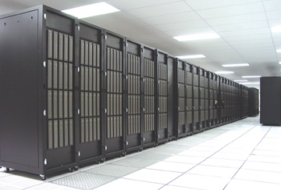
Lemieux
Lighting

Slide 11

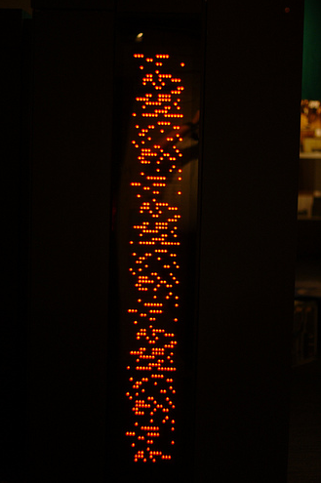
Connection Machines - SIMDs
CM-2
CM-5

Slide 12
Example: Finding the Largest Key in an Array
In order to find the largest key in an array of size n, at least n-1 comparisons must be done.
A parallel version of this algorithm will still perform the same amount of compares, but by doing them in parallel it will finish sooner.

Slide 13
Example: Finding the Largest Key in an Array
Assume that n is a power of 2 and we have n/2 processors executing the algorithm in parallel.
Each Processor reads two array elements into local variables called first and second
It then writes the larger value into the first of the array slots that it has to read.
Takes lg n steps for the largest key to be placed in S[1]

Slide 14
Example: Finding the Largest Key in an Array
3
12
7
6
8
11
19
13
P1
P2
P3
P4
Read
12
3
6
7
11
8
13
19
First
Second
First
Second
First
Second
First
Second
Write
12
12
7
6
11
11
19
13

Slide 15
Example: Finding the Largest Key in an Array
12
12
7
6
11
11
19
13
P1
P3
Read
7
12
19
11
Write
12
12
7
6
19
11
19
13

Slide 16
Example: Finding the Largest Key in an Array
12
12
7
6
19
11
19
13
Read
P1
19
12
Write
19
12
7
6
19
11
19
13

Slide 18
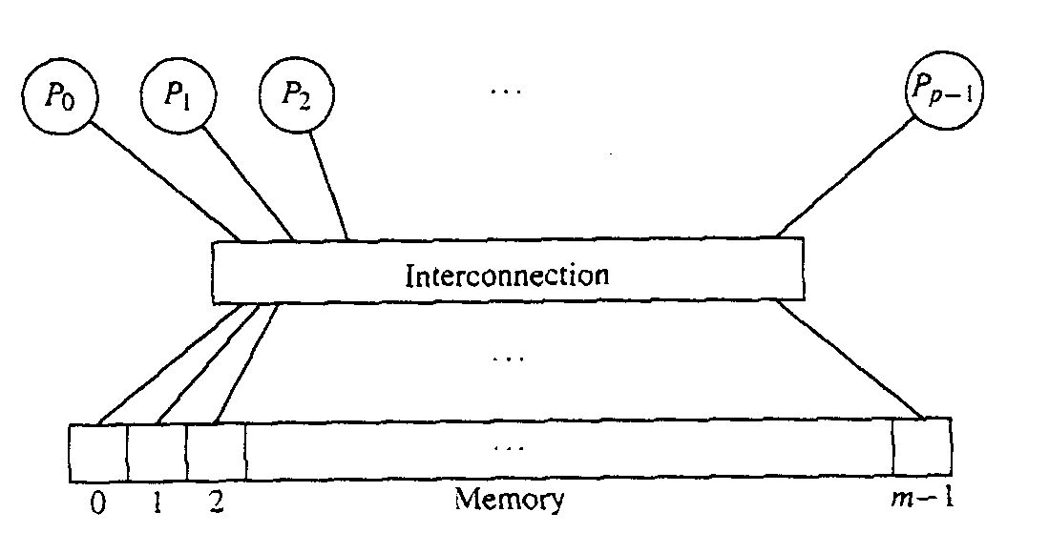
A Simple Model for Parallel Processing
Parallel Random Access Machine (PRAM) model
  A number of processors all can access
  A large shared memory
  All processors are synchronized
  All processors are running the same program
    Each processor has an unique id, pid and
    May be instructed to do different things depending on their pid (if pid < 200, do this, else do that)

Slide 19
The PRAM Model
Parallel Random Access Machine
  Theoretical model for parallel machines
  p processors with uniform access to a large memory bank
  UMA (uniform memory access) – Equal memory access time for any processor to any address

Slide 20
PRAM Models
PRAM models vary according
  How they handle write conflicts
  The models differ in how fast they can solve various problems.
Concurrent Read Exclusive Write (CREW)
  Only one processor is allow to write to
  one particular memory cell at any one step
Concurrent Read Concurrent Write (CRCW)
  An algorithm that works correctly for CREW
  will also work correctly for CRCW
  but not vice versa

Slide 21
Summary of Memory Protocols
Exclusive-Read Exclusive-Write
Exclusive-Read Concurrent-Write
Concurrent-Read Exclusive-Write
Concurrent-Read Concurrent-Write
If concurrent write is allowed we must decide which value to accept

Slide 22
More Details on the PRAM Model
Memory size is infinite, number of processors in unbounded
No direct communication between processors
  they communicate via the memory
  they can operate in an asynchronous fashion
Every processor accesses any memory location in 1 cycle
Typically all processors execute the same algorithm in a synchronous fashion
  READ phase
  COMPUTE phase
  WRITE phase
Some subset of the processors can stay idle (e.g., even numbered processors may not work, while odd processors do, and conversely)
P₁
Shared
Memory
P₂
P₃
.
.
.
P_{N}

Slide 23
PRAM CW?
What ends up being stored when multiple writes occur?
  priority CW: processors are assigned priorities and the top priority processor is the one that counts for each group write
  Fail common CW: if values are not equal, no change
  Collision common CW: if values not equal, write a “failure value”
  Fail-safe common CW: if values not equal, then algorithm aborts
  Random CW: non-deterministic choice of the value written
  Combining CW: write the sum, average, max, min, etc. of the values
  etc.
The above means that when you write an algorithm for a CW PRAM you can do any of the above at any different points in time
It doesn’t corresponds to any hardware in existence and is just a logical/algorithmic notion that could be implemented in software
In fact, most algorithms end up not needing CW

Slide 24
PRAM Example 1
Problem:
  We have a linked list of length n
  For each element i, compute its distance to the end of the list:
  d[i] = 0 if next[i] = NIL
  d[i] = d[next[i]] + 1 otherwise
Sequential algorithm in O(n)
We can define a PRAM algorithm in O(log n)
  Associate one processor to each element of the list
  At each iteration split the list in two with odd-placed and even-placed elements in different lists
  List size is divided by 2 at each step, hence O(log n)

Slide 25
PRAM Example 1
Principle:
Look at the next element
Add its d[i] value to yours
Point to the next element’s next element
1
1
1
1
1
0
The size of each list
is reduced by 2 at
each step, hence the
O(log n) complexity
2
2
2
2
1
0
4
4
3
2
1
0
5
4
3
2
1
0

Slide 26
PRAM Example 1
Algorithm
forall i
if next[i] == NIL then d[i] ← 0 else d[i] ← 1
while there is an i such that next[i] ≠ NIL
forall i
if next[i] ≠ NIL then
d[i] ← d[i] + d[next[i]]
next[i] ← next[next[i]]
What about the correctness of this algorithm?

Slide 27
forall Loop
At each step, the updates must be synchronized so that pointers point to the right things:
next[i] ← next[next[i]]
Ensured by the semantic of forall
Nobody really writes it out, but one mustn’t forget that it’s really what happens underneath
forall i
tmp[i] = B[i]
forall i
A[i] = tmp[i]
forall i
A[i] = B[i]

Slide 28
while Condition
while there is an i such that next[i] ≠NULL
How can one do such a global test on a PRAM?
  Cannot be done in constant time unless the PRAM is CRCW
    At the end of each step, each processor could write to a same memory location TRUE or FALSE depending on next[i] being equal to NULL or not, and one can then take the AND of all values (to resolve concurrent writes)
    On a PRAM CREW, one needs O(log n) steps for doing a global test like the above
In this case, one can just rewrite the while loop into a for loop, because we have analyzed the way in which the iterations go:
  for step = 1 to ⎡log n⎤

Slide 29
What Type of PRAM?
The previous algorithm does not require a CW machine, but:
  tmp[i] ← d[i] + d[next[i]]
  which requires concurrent reads on proc i and j such that j = next[i].
Solution:
  split it into two instructions:
  tmp2[i] ← d[i]
  tmp[i] ← tmp2[i] + d[next[i]]
  (note that the above are technically in two different forall loops)
Now we have an execution that works on a EREW PRAM, which is the most restrictive type

Slide 30
Final Algorithm on a EREW PRAM
forall i
if next[i] == NILL then d[i] ← 0 else d[i] ← 1
for step = 1 to ⎡log n⎤
forall i
if next[i] ≠ NIL then
tmp[i] ← d[i]
d[i] ← tmp[i] + d[next[i]]
next[i] ← next[next[i]]
O(1)
O(log n)
O(log n)
O(1)
Conclusion: One can compute the length of a list of size n in time O(log n) on any PRAM

Slide 31
Are All PRAMs Equivalent?
Consider the following problem
  Given an array of n elements, e_{i=1,n}, all distinct, find whether some element e is in the array
On a CREW PRAM, there is an algorithm that works in time O(1) on n processors:
  Initialize a boolean to FALSE
  Each processor i reads e_{i} and e and compare them
  If equal, then write TRUE into the boolean (only one processor will write, so we’re ok for CREW)

Slide 32
Are All PRAMs Equivalent?
One a EREW PRAM, one cannot do better than log n
  Each processor must read e separately
  At worst a complexity of O(n), with sequential reads
  At best a complexity of O(log n), with series of “doubling” of the value at each step so that eventually everybody has a copy (just like a broadcast in a binary tree, or in fact a k-ary tree for some constant k)
  Generally, “diffusion of information” to n processors on an EREW PRAM takes O(log n)
Conclusion: CREW PRAMs are more powerful than EREW PRAMs

Slide 33
This is a Typical Question for Various Parallel Models
Is model A more powerful than model B?
Basically, you are asking if one can simulate the other.
Whether or not the model maps to a “real” machine, is another question of interest.
Often a research group tries to build a machine that has the characteristics of a given model.

Slide 34
Simulation Theorem
Simulation theorem: Any algorithm running on a CRCW PRAM with p processors cannot be more than O(log p) times faster than the best algorithm on a ECEW PRAM with p processors for the same problem
Proof: We will “simulate” concurrent writes
    When Pi writes value x_{i} to address l_{i}, one replaces the write by an (exclusive) write of (l_{i ,}x_{i}) to A[i], where A[i] is some auxiliary array with one slot per processor
    Then one sorts array A by the first component of its content
    Processor i of the EREW PRAM looks at A[i] and A[i-1]
      If the first two components are different or if i = 0, write value x_{i} to address l_{i}
    Since A is sorted according to the first component, writing is exclusive

Slide 35
Proof (continued)
Picking one processor for each competing write
P₀
12
8
A[0]=(8,12) P0 writes
A[1]=(8,12) P1 nothing
A[2]=(29,43) P2 writes
A[3]=(29,43) P3 nothing
A[4]=(29,43) P4 nothing
A[5]=(92,26) P5 writes
P0 → (29,43) = A[0]
P1 → (8,12) = A[1]
P2 → (29,43) = A[2]
P3 → (29,43) = A[3]
P4 → (92,26) = A[4]
P5 → (8,12) = A[5]
P₁
P₂
43
29
sort
P₃
P₄
26
92
P₅

Slide 36
Proof (continued)
Note that we said that we just sort array A
If we have an algorithm that sorts p elements with O(p) processors in O(log p) time, we’re set
Turns out, there is such an algorithm: Cole’s Algorithm.
  Basically a merge-sort in which lists are merged in constant time!
  It’s beautiful, but we don’t really have time for it, and it’s rather complicated
Therefore, the proof is complete.

Slide 37
Brent Theorem
Theorem: Let A be an algorithm with m operations that runs in time t on some PRAM (with some number of processors). It is possible to simulate A in time O(t + m/p) on a PRAM of same type with p processors
Example: maximum of n elements on an EREW PRAM
  Clearly can be done in O(log n) with O(n) processors
    Compute series of pair-wise maxima
    The first step requires O(n/2) processors
  What happens if we have fewer processors?
  By the theorem, with p processors, one can simulate the same algorithm in time O(log n + n / p)
  If p = n / log n, then we can simulate the same algorithm in O(log n + log n) = O(log n) time, which has the same complexity!
  This theorem is useful to obtain lower-bounds on number of required processors that can still achieve a given complexity.

Slide 38
Computing the Complexity of Parallel Algorithms
Unlike sequential algorithms, we do not have one kind of machine on which we must do our algorithm development and our complexity analysis
Moreover, the complexity is a function of the input size predominately.
The following will need to be considered for parallel machines besides input size:
  What is the type of machine – SIMD?, MIMD?, others?
  How many processors?
  How can data be exchanged between processors – shared memory?, interconnection network?

Slide 39
Example: Merge Sort
8
1
4
5
2
7
3
6
P1
P2
P3
P4
1
8
4
5
2
7
3
6
P1
P2
1
4
5
8
2
3
6
7
P1
1
2
3
4
5
6
7
8
Notes:
Mention that merges on each line happen simultaneously, so only three iterations seen here.

Slide 40
Merge Sort Analysis
Number of compares
  1 + 3 + … + (2^{i}-1) + … + (n-1)
  ∑_{i=1..lg(n)} 2^{i}-1 = 2n-2-lgn = Θ(n)
We have improved from nlg(n) to n simply by applying the old algorithm to parallel computing, by altering the algorithm we can further improve merge sort to (lgn)²

Slide 41
O(1) Sorting Algorithm
We assume a CRCW PRAM where concurrent write is handled with addition
for(int i=1; i<=n; i++) {
for(int j=1; j<=n; j++) {
if(X[i] > X[j])
Processor Pij stores 1 in memory location m_{i}
else
Processor Pij stores 0 in memory location m_{i} } }

Slide 42
O(1) Sorting Algorithm with n² Processors
Unsorted List {4, 2, 1, 3}
Note: Each is a different processor
P₁₁(4,4) P₁₂(4,2) P₁₃(4,1) P₁₄(4,3)
P₂₁(2,4) P₂₂(2,2) P₂₃(2,1) P₂₄(2,3)
P₃₁(1,4) P₃₂(1,2) P₃₃(1,1) P₃₄(1,3)
P₄₁(3,4) P₄₂(3,2) P₄₃(3,1) P₄₄(3,3)
0+1+1+1 = 3 4 is in position 3 when sorted
0+0+1+0 = 1 2 is in position 1 when sorted
0+0+0+0 = 0 1 is in position 0 when sorted
0+1+1+0 = 2 3 is in position 2 when sorted

Slide 43
MIMDs

Slide 44
Embarrassingly Parallel Problem
In parallel computing, an embarrassingly parallel problem is one for which little or no effort is required to separate the problem into a number of parallel tasks.
This is often the case where there exists no dependency (or communication) between those parallel tasks.
Embarrassingly parallel problems are ideally suited to distributed computing and are also easy to perform on server farms which do not have any of the special infrastructure used in a true supercomputer cluster. They are thus well suited to large, internet based distributed platforms.

Slide 45
A common example of an embarrassingly parallel problem lies within graphics processing units (GPUs) for tasks such as 3D projection, where each pixel on the screen may be rendered independently.
Some other examples of embarrassingly parallel problems include:
  The Mandelbrot set and other fractal calculations, where each point can be calculated independently.
  Rendering of computer graphics. In ray tracing, each pixel may be rendered independently.
  In computer animation, each frame may be rendered independently.

Slide 46
Brute force searches in cryptography.
BLAST searches in bioinformatics.
Large scale face recognition that involves comparing thousands of input faces with similarly large number of faces.
Computer simulations comparing many independent scenarios, such as climate models.
Genetic algorithms and other evolutionary computation metaheuristics.
Ensemble calculations of numerical weather prediction.
Event simulation and reconstruction in particle physics.

Slide 47
A Few Other Current Applications that Utilize Parallel Architectures
Computer graphics processing
Video encoding
Accurate weather forecasting
Often in a dynamic programming algorithm a given row or diagonal can be computed simultaneously
  This makes many dynamic programming algorithms amenable for parallel architectures

Slide 48

Atmospheric Model
Typically, these points are located on a rectangular latitude-longitude grid of size 15-30 , in the range 50--500.
A vector of values is maintained at each grid point, representing quantities such as pressure, temperature, wind velocity, and humidity.
The three-dimensional grid used to represent the state of the atmosphere. Values maintained at each grid point represent quantities such as pressure and temperature.

Slide 49
Approaches to the Design of Parallel Algorithms
Modify an existing sequential algorithm
  Exploiting those parts of the algorithm that are naturally parallelizable.
Design a completely new parallel algorithm that
  May have no natural sequential analog.
Brute force Methods for parallel processing:
  Use an existing sequential algorithm but
    Each processor using differential initial conditions
  Using compiler to optimize sequential algorithm
  Using advanced CPU to optimize code

Slide 50
Speedup and Efficiency of Parallel Algorithms
Let T*(n) be the time complexity of a sequential algorithm to solve a problem P of input size n
Let T_{p}(n) be the time complexity of a parallel algorithm to solves P on a parallel computer with p processors
Speedup
  S_{p}(n) = T*(n) / T_{p}(n)
  <claimed by some; disputed by others>
    S_{p}(n) <= p
    Best possible, S_{p}(n) = p when T_{p}(n) = T*(n)/p

Slide 51
Speedup and Efficiency of Parallel Algorithms
Let T*(n) be the time complexity of a sequential algorithm to solve a problem P of input size n
Let T_{p}(n) be the time complexity of a parallel algorithm to solves P on a parallel computer with p processors
Efficiency
  E_{p}(n) = T₁(n) / (p T_{p}(n))
    where T₁(n) is when the parallel algorithm runs on 1 processor
  Best possible, E_{p}(n) = 1

Slide 52
A Class of Problems NC
The class NC consists of problems that
  Can be solved by parallel algorithm using
    Polynomially bounded number of processors p(n)
    p(n) ∈ O(n^{k}) for problem size n and some constant k
  The number of time steps bounded by a polynomial is the logarithm of the problem size n
    T(n) ∈ O( (log n)^{m} ) for some constant m
Theorem:
  NC ⊆ P

Slide 53
Parallel Programming Paradigms and Machines
Two primary programming paradigms:
  SPMD (single program, multiple data)
  MPMD (multiple programs, multiple data)
There Are No PRAM Machines, but parallel machines are often classified into two groups
  SIMD (single instruction, multiple data)
  MIMD (multiple instruction, multiple data)
which clearly mimic the programming paradigms.
A network of distributed computers all working on the same problem, models a MIMD machine.

Slide 54
SIMD Machines
SIMD machines are coming in (again) as dual and quad processors.
In the past, there have been several SIMD machines-
  Connection Machine - 64K processors
  ILLIAC was the name given to a series of supercomputers built at the University of Illinois at Urbana-Champaign. In all, five computers were built in this series between 1951 and 1974. Design of the ILLIAC IV had 256 processors
  Today: ClearSpeed: 192 high-performance processing elements, each with: Dual 32 & 64-bit FPU and 6 Kbytes high bandwidth memory
Most of the top supercomputers are parallel machines:
http://www.top500.org/lists/2008/11

Slide 55
500 Fastest Supercomputers
http://www.top500.org/lists/2008/11
Some of these are MIMDs and some are SIMDs (and some we don't know for sure because of propriety information, but timings indicate often which is which.)
The Top500 list is updated twice yearly (Nov and June) by researchers at the University of Mannheim, the University of Tennessee and the U.S. Energy Department's Lawrence Berkeley National Laboratory.
It ranks computers by how many trillions of calculations per second, or teraflops, they can perform using algebraic calculations in a test called Linpack.

Slide 56
I. Parallelism
Some of the next slides are due to Rebecca Hartman-Baker at Oak Ridge National Labs.
She permits their use for non-commercial, educational use only.

Slide 57
Parallelization Concepts
When performing task, some subtasks depend on one another, while others do not
Example: Preparing dinner
  Salad prep independent of lasagna baking
  Lasagna must be assembled before baking
Likewise, in solving problems, some tasks are independent of one another

Slide 58
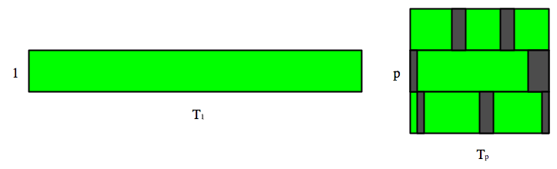
Serial vs. Parallel
Serial: tasks must be performed in sequence
Parallel: tasks can be performed independently in any order

Slide 59




Serial vs. Parallel: Example
Example: Preparing dinner
  Serial tasks: making sauce, assembling lasagna, baking lasagna; washing lettuce, cutting vegetables, assembling salad
  Parallel tasks: making lasagna, making salad, setting table

Slide 60


Serial vs. Parallel: Example
Could have several chefs, each performing one parallel task
This is concept behind parallel computing

Slide 61
SPMD vs. MPMD
SPMD: Write single program that will perform same operation on multiple sets of data
  Multiple chefs baking many lasagnas
  Rendering different frames of movie
MPMD: Write different programs to perform different operations on multiple sets of data
  Multiple chefs preparing four-course dinner
  Rendering different parts of movie frame
Can also write hybrid program in which some processes perform same task

Slide 62
Multilevel Parallelism
May be subtasks within a task that can be performed in parallel
  Salad and lasagna making are parallel tasks; chopping of vegetables for salad are parallelizable subtasks
We can use subgroups of processors (chefs) to perform parallelizable subtasks

Slide 63

Discussion: Jigsaw Puzzle*
Suppose we want to do 5000 piece jigsaw puzzle
Time for one person to complete puzzle: n hours
How can we decrease wall time to completion?
* Thanks to Henry Neeman for example

Slide 64

Discussion: Jigsaw Puzzle
Add another person at the table
  Effect on wall time
  Communication
  Resource contention
Add p people at the table
  Effect on wall time
  Communication
  Resource contention

Slide 65

Discussion: Jigsaw Puzzle
What about: p people, p tables, 5000/p pieces each?
What about: one person works on river, one works on sky, one works on mountain, etc.?

Slide 66
Parallel Algorithm Design: PCAM
Partition: Decompose problem into fine-grained tasks to maximize potential parallelism
Communication: Determine communication pattern among tasks
Agglomeration: Combine into coarser-grained tasks, if necessary, to reduce communication requirements or other costs
Mapping: Assign tasks to processors, subject to tradeoff between communication cost and concurrency

Slide 67
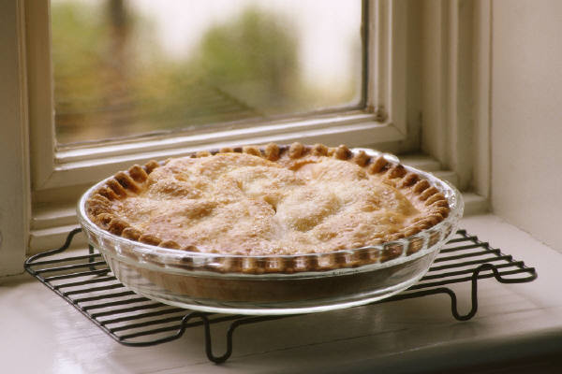
Example: Computing Pi
We want to compute π
One method: method of darts*
Ratio of area of square to area of inscribed circle proportional to π

Slide 68

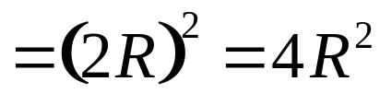
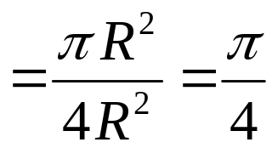

Method of Darts
Imagine dartboard with circle of radius R inscribed in square
Area of circle
Area of square
Area of circle
Area of square

Slide 69
Method of Darts
So, ratio of areas proportional to π
How to find areas?
  Suppose we threw darts (completely randomly) at dartboard
  Could count number of darts landing in circle and total number of darts landing in square
  Ratio of these numbers gives approximation to ratio of areas
  Quality of approximation increases with number of darts
π = 4 × # darts inside circle
# darts thrown

Slide 70
Method of Darts
How in the world do we simulate this experiment on computer?
  Decide on length R
  Generate pairs of random numbers (x, y) such that -R ≤ x, y ≤ R
  If (x, y) within circle (i.e. if (x²+y²) ≤ R²), add one to tally for inside circle
  Lastly, find ratio

Slide 71
Parallelization Strategies for MIMD Models
What tasks are independent of each other?
What tasks must be performed sequentially?
Use PCAM parallel algorithm design strategy due to Ian Foster.
PCAM = Partition, Communicate, Agglomerate, and Map.
Note: Some of the next slides on this topic are adapted and modified from Randy H. Katz’s course.

Slide 72
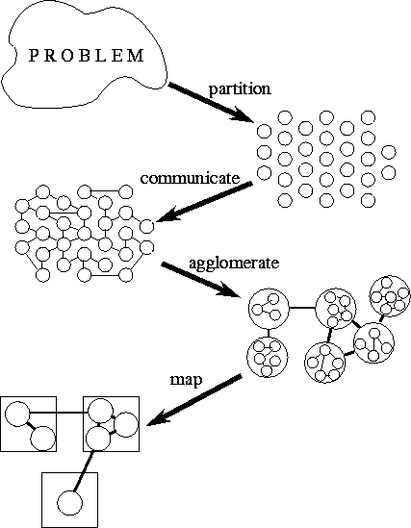
Program Design Methodology for MIMDs

Slide 73
Ian Foster’s Scheme
Partitioning.
  The computation that is to be performed and the data operated on by this computation are decomposed into small tasks.
  Practical issues such as the number of processors in the target computer are ignored, and attention is focused on recognizing opportunities for parallel execution.
Communication.
  The communication required to coordinate task execution is determined, and appropriate communication structures and algorithms are defined.
Agglomeration.
  The task and communication structures defined in the first two stages of a design are evaluated with respect to performance requirements and implementation costs.
  If necessary, tasks are combined into larger tasks to improve performance or to reduce development costs.

Slide 74
Mapping.
  Each task is assigned to a processor in a manner that attempts to satisfy the competing goals of maximizing processor utilization and minimizing communication costs.
  Mapping can be specified statically or determined at runtime by load-balancing algorithms.
  Looking at these steps for the dart throwing problem …

Slide 75

Partition or Decompose
“Decompose problem into fine-grained tasks to maximize potential parallelism”
Finest grained task: throw of one dart
Each throw independent of all others
If we had huge computer, could assign one throw to each processor

Slide 76
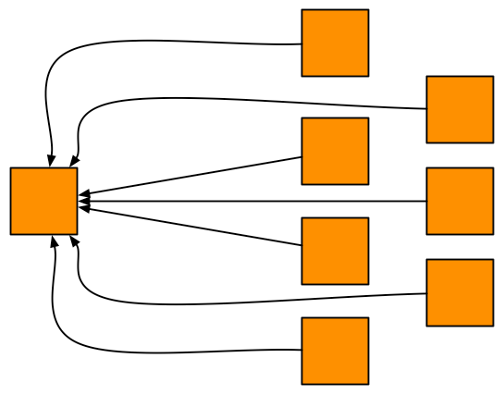
Communication
“Determine communication pattern among tasks”
Each processor throws dart(s) then sends results back to manager process

Slide 77
Agglomeration
“Combine into coarser-grained tasks, if necessary, to reduce communication requirements or other costs”
To get good value of π, must use millions of darts
We don’t have millions of processors available
Furthermore, communication between manager and millions of worker processors would be very expensive
Solution: divide up number of dart throws evenly between processors, so each processor does a share of work

Slide 78
Mapping
“Assign tasks to processors, subject to tradeoff between communication cost and concurrency”
Assign role of “manager” to processor 0
Processor 0 will receive tallies from all the other processors, and will compute final value of π
Every processor, including manager, will perform equal share of dart throws

Slide 79
Program Partitioning
The partitioning stage of a design is intended to expose opportunities for parallel execution.
  Thus, the focus is on defining a large number of small tasks in order to yield what is termed a fine-grained decomposition of a problem.
  Just as fine sand is more easily poured than a pile of bricks, a fine-grained decomposition provides the greatest flexibility in terms of potential parallel algorithms.
  In later design stages, evaluation of communication requirements, the target architecture, or software engineering issues may lead us to forego opportunities for parallel execution identified at this stage.
  We then revisit the original partition and agglomerate tasks to increase their size, or granularity.
  However, in this first stage we wish to avoid prejudging alternative partitioning strategies.

Slide 80
Good Partitioning
A good partition divides into small pieces both the computation associated with a problem and the data on which this computation operates.
When designing a partition, programmers most commonly first focus on the data associated with a problem, then determine an appropriate partition for the data, and finally work out how to associate computation with data.
This partitioning technique is termed domain decomposition.
The alternative approach---first decomposing the computation to be performed and then dealing with the data---is termed functional decomposition.
These are complementary techniques which may be applied to different components of a single problem or even applied to the same problem to obtain alternative parallel algorithms.

Slide 81
In this first stage of a design, we seek to avoid replicating computation and data.
That is, we seek to define tasks that partition both computation and data into disjoint sets.
Like granularity, this is an aspect of the design that we may revisit later.
It can be worthwhile replicating either computation or data if doing so allows us to reduce communication requirements.

Slide 82
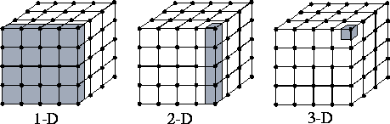
Domain Decomposition
Domain decompositions for a problem involving a three-dimensional grid.
One-, two-, and three-dimensional decompositions are possible; in each case, data associated with a single task are shaded.
A three-dimensional decomposition offers the greatest flexibility and is adopted in the early stages of a design.

Slide 83
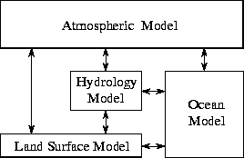
Functional decomposition in a computer model of climate.
Each model component can be thought of as a separate task, to be parallelized by domain decomposition.
Arrows represent exchanges of data between components during computation:
  The atmosphere model generates wind velocity data that are used by the ocean model
  The ocean model generates sea surface temperature data that are used by the atmosphere model, and so on.

Slide 84
Communication
The tasks generated by a partition are intended to execute concurrently but cannot, in general, execute independently.
The computation to be performed in one task will typically require data associated with another task.
Data must then be transferred between tasks so as to allow computation to proceed.
This information flow is specified in the communication phase of a design.
We use a variety of examples to show how communication requirements are identified and how channel structures and communication operations are introduced to satisfy these requirements.
For clarity in exposition, we categorize communication patterns along four loosely orthogonal axes: local/global, structured/unstructured, static/dynamic, and synchronous/asynchronous.

Slide 85
Types of Communication –Rather Obvious Definitions
In local communication, each task communicates with a small set of other tasks (its ‘neighbors''); in contrast, global communication requires each task to communicate with many tasks.
In structured communication, a task and its neighbors form a regular structure, such as a tree or grid; in contrast, unstructured communication networks may be arbitrary graphs.
In static communication, the identity of communication partners does not change over time; in contrast, the identity of communication partners in dynamic communication structures may be determined by data computed at runtime and may be highly variable.
In synchronous communication, producers and consumers execute in a coordinated fashion, with producer/consumer pairs cooperating in data transfer operations; in contrast, asynchronous communication may require that a consumer obtain data without the cooperation of the producer.

Slide 86
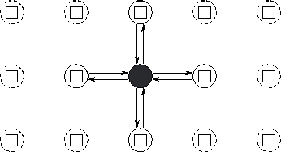
Local Communication
Task and channel structure for a two-dimensional finite difference computation with five-point update stencil.
In this simple fine-grained formulation, each task encapsulates a single element of a two-dimensional grid and must both send its value to four neighbors and receive values from four neighbors.
Only the channels used by the shaded task are shown.

Slide 87
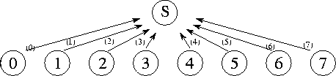
Global Communication
A centralized summation algorithm that uses a central manager task (S) to sum N numbers distributed among N tasks.
Here, N=8 , and each of the 8 channels is labeled with the number of the step in which they are used.

Slide 88


Distributing Communication and Computation
We first consider the problem of distributing a computation and communication associated with a summation.
We can distribute the summation of the N numbers by making each task i , 0<i<N-1 , compute the sum:
A summation algorithm that connects N tasks in an array in order to sum N numbers distributed among these tasks.
Each channel is labeled with the number of the step in which it is used and the value that is communicated on it.

Slide 89
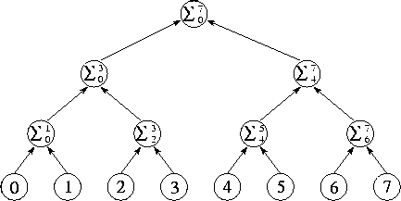
Divide and Conquer
Tree structure for divide-and-conquer summation algorithm with N=8 .
The N numbers located in the tasks at the bottom of the diagram are communicated to the tasks in the row immediately above; these each perform an addition and then forward the result to the next level.
The complete sum is available at the root of the tree after log N steps.

Slide 90
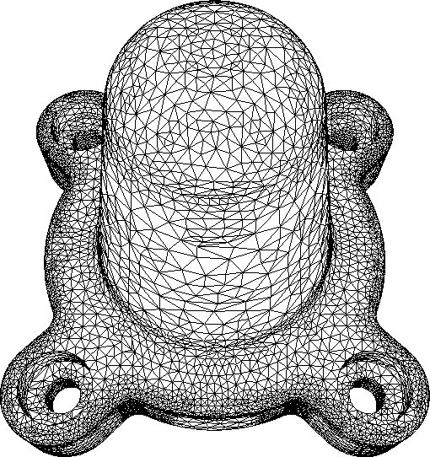
Unstructured and Dynamic Communication
Example of a problem requiring unstructured communication.
In this finite element mesh generated for an assembly part, each vertex is a grid point.
An edge connecting two vertices represents a data dependency that will require communication if the vertices are located in different tasks.
Note that different vertices have varying numbers of neighbors. (Image courtesy of M. S. Shephard.)

Slide 91
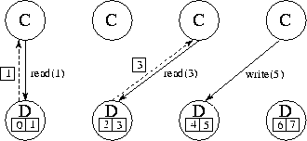
Asynchronous Communication
Using separate ``data tasks'' to service read and write requests on a distributed data structure.
In this figure, four computation tasks (C) generate read and write requests to eight data items distributed among four data tasks (D).
Solid lines represent requests; dashed lines represent replies.
One compute task and one data task could be placed on each of four processors so as to distribute computation and data equitably.

Slide 92
Agglomeration
In the third stage, agglomeration, we move from the abstract toward the concrete.
We revisit decisions made in the partitioning and communication phases with a view to obtaining an algorithm that will execute efficiently on some class of parallel computer.
In particular, we consider whether it is useful to combine, or agglomerate, tasks identified by the partitioning phase, so as to provide a smaller number of tasks, each of greater size.
We also determine whether it is worthwhile to replicate data and/or computation.

Slide 93
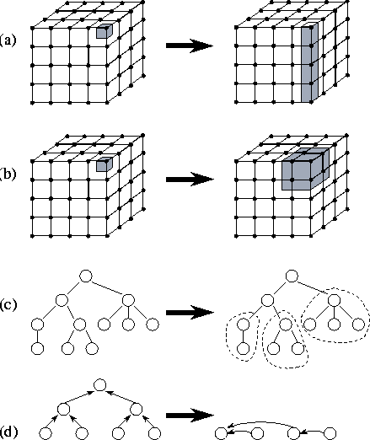
Examples of Agglomeration
In (a), the size of tasks is increased by reducing the dimension of the decomposition from three to two.
In (b), adjacent tasks are combined to yield a three-dimensional decomposition of higher granularity.
In (c), subtrees in a divide-and-conquer structure are coalesced.
In (d), nodes in a tree algorithm are combined.

Slide 94
Increasing Granularity
In the partitioning phase of the design process,
efforts are focused on defining as many tasks as possible.
This forces us to consider a wide range of opportunities for parallel execution.
Note that defining a large number of fine-grained tasks does not necessarily produce an efficient parallel algorithm.
One critical issue influencing parallel performance is communication costs.
On most parallel computers, computing must stop in order to send and receive messages.
Thus, we can improve performance by reducing the amount of time spent communicating.

Slide 95
Increasing Granularity
Clearly, performance improvement can be achieved by sending less data.
Perhaps less obviously, it can also be achieved by using fewer messages, even if we send the same amount of data.
This is because each communication incurs not only a cost proportional to the amount of data transferred but also a fixed startup cost.

Slide 96
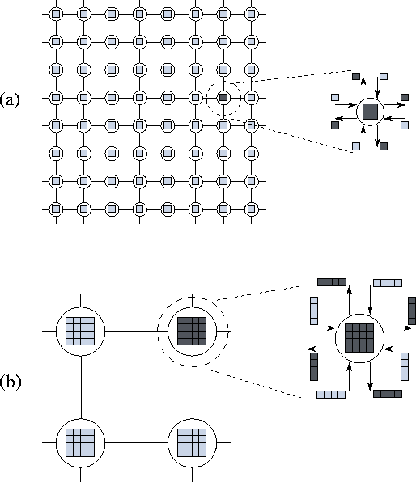
The figure shows fine- and coarse-grained two-dimensional partitions of this problem. In each case, a single task is exploded to show its outgoing messages (dark shading) and incoming messages (light shading).
In (a), a computation on an 8x8 grid is partitioned into 64 tasks, each responsible for a single point, while in (b) the same computation is partitioned into 2x2=4 tasks, each responsible for 16 points. In (a), 64x4=256 communications are required, 4 per task; these transfer a total of 256 data values.
In (b), only 4x4=16 communications are required, and only 16x4=64 data values are transferred.

Slide 97
Mapping
In the fourth and final stage of the parallel algorithm design process, we specify where each task is to execute.
This mapping problem does not arise on uniprocessors or on shared-memory computers that provide automatic task scheduling.
In these computers, a set of tasks and associated communication requirements is a sufficient specification for a parallel algorithm; operating system or hardware mechanisms can be relied upon to schedule executable tasks to available processors.
Unfortunately, general-purpose mapping mechanisms have yet to be developed for scalable parallel computers.
In general, mapping remains a difficult problem that must be explicitly addressed when designing parallel algorithms.

Slide 98
Mapping
The goal in developing mapping algorithms is normally to minimize total execution time.
We use two strategies to achieve this goal:
  We place tasks that are able to execute concurrently on different processors, so as to enhance concurrency.
  We place tasks that communicate frequently on the same processor, so as to increase locality.
The mapping problem is known to be NP -complete.
However, considerable knowledge has been gained on specialized strategies and heuristics and the classes of problem for which they are effective.
Next, we provide a rough classification of problems and present some representative techniques.

Slide 99
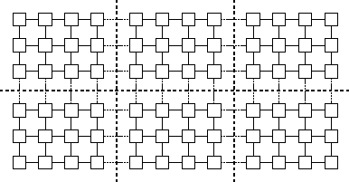
Mapping Example
Mapping in a grid problem in which each task performs the same amount of computation and communicates only with its four neighbors.
The heavy dashed lines delineate processor boundaries.
The grid and associated computation is partitioned to give each processor the same amount of computation and to minimize off-processor communication.

Slide 100
Load-Balancing Algorithms
A wide variety of both general-purpose and application-specific load-balancing techniques have been proposed for use in parallel algorithms based on domain decomposition techniques.
We review several representative approaches here namely recursive bisection methods, local algorithms, probabilistic methods, and cyclic mappings.
These techniques are all intended to agglomerate fine-grained tasks defined in an initial partition to yield one coarse-grained task per processor.
Alternatively, we can think of them as partitioning our computational domain to yield one sub-domain for each processor.
For this reason, they are often referred to as partitioning algorithms.

Slide 101
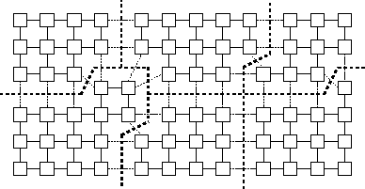
Graph Partitioning Problem
Load balancing in a grid problem.
Variable numbers of grid points are placed on each processor so as to compensate for load imbalances.
This sort of load distribution may arise if a local load-balancing scheme is used in which tasks exchange load information with neighbors and transfer grid points when load imbalances are detected.

Slide 102
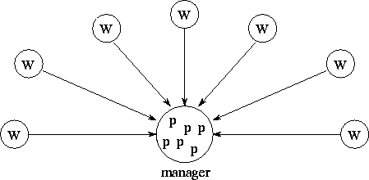
Task Scheduling Algorithms
Manager/worker load-balancing structure.
Workers repeatedly request and process problem descriptions; the manager maintains a pool of problem descriptions ( p) and responds to requests from workers.

